Slide 1

Machine Learning in Healthcare
Technical Overview
Priyanka Bhamare
Rishabh Kalai
Sadhana Suresh Chettiar

Slide 2
Outline of Discussion
Pandemic Management
Drug Development
Genetic Data Analysis

Slide 3
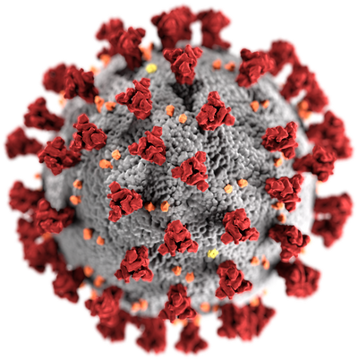
Pandemic Management
Bayesian Belief Network (BBN)
Causal Modelling

Slide 4
Introduction
Transformative Role of ML
Central to Medical Advancements
Key ML Methods
Predictive Analytics: Infection Rates, Enables Pre-emptive Measures
Epidemiological Modeling: SEIRD – Modelling Disease Spread
Risk Factor Analysis
BBNs in Focus: Critical capability in understanding and prediction of pandemic risk factors.
Notes:
Overview of ML in Healthcare
The advent of ML signifies a paradigm shift in healthcare strategies, underscoring a proactive stance in pandemic mitigation and management.
Fundamental to Medical Progress: Instrumental in the rapid conceptualization and deployment of vaccines, ML has redefined response mechanisms to public health emergencies.
Key ML Methodologies
Predictive Analytics: Leveraging statistical and machine learning models to forecast infection rates, enabling preemptive healthcare measures.
Epidemiological Modeling: The SEIRD model segments a population into five compartments—Susceptible (S), Exposed (E), Infected (I), Recovered (R), and Deceased (D), to model spread of disease and impact
Determinants Analysis: Applying ML to discern and quantify the impact of various risk determinants on public health during a pandemic.
Bayesian Belief Networks (BBNs)
Strategic Forecasting Tool: Employing BBNs for their robust capacity in the nuanced assessment and prediction of pandemic-related risk variables.

Slide 5
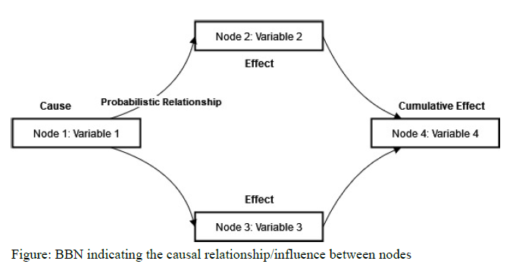
Model : Bayesian Belief Network
Notes:
Bayesian Belief Networks (BBNs)
A graphical framework for probabilistic reasoning and decision-making in complex domains, such as healthcare and pandemic forecasting.
Graphical Representation
Nodes: Signify distinct variables, each representing a potential contributor to an outcome or an observable condition.
Edges: Denote the direct probabilistic influence and dependencies among variables, illustrating a cause-and-effect relationship.
Functionality of BBNs
Causal Influence: The architecture delineates how one variable (Node 1) can causally affect another (Node 2 and Node 3), leading to a chain of effects.
Probabilistic Relationships: BBNs encapsulate the uncertainty inherent in real-world scenarios, quantifying the likelihood of outcomes based on inter-nodal relationships.
Cumulative Effect: The network culminates in the synthesis of effects on a terminal node (Node 4), which integrates the compounded influence from preceding nodes.

Slide 6
Qualitative Aspects
Graphical Structure: Visual representation through a Directed Acyclic Graph (DAG)
Nodes
Edges
Quantitative Aspects
Conditional Probability Tables (CPTs)
Bayesian Inference
Notes:
Qualitative Aspects of BBNs
Graphical Structure:
Directed Acyclic Graph (DAG): A systematic, non-circular representation that maps the dependencies between variables.
Nodes: Symbolize variables or states in the model, each representing a potential influence in the network.
Edges: Illustrate the directional influences between nodes, portraying the flow of conditional dependencies.
Quantitative Aspects of BBNs
Conditional Probability Tables (CPTs):
Function as the backbone of the BBN, assigning likelihoods to the relationships between connected nodes, and formulating the basis for probabilistic inferences.
Bayesian Inference:
A statistical method within BBNs that updates the probability estimates for a hypothesis as more evidence or information becomes available.

Slide 7
Advantages
Predictive Power
Models risk factor interdependencies; Enhances outcome accuracy
Agility
Integrates new data fast; Supports strategy adjustments
Disadvantages
Data Demands
Requires extensive, quality data; Timeliness impacts effectiveness
Complexity
Challenges non-expert use; May need extra support for insights
Notes:
Advantages of BBNs
Predictive Power:
Employs risk factor interdependencies modeling to enhance prediction accuracy.
Crucial for outcome precision in clinical prognosis and public health forecasts.
Agility:
Rapidly assimilates new data to remain current and relevant.
Facilitates prompt and effective strategy adjustments in real-time pandemic response.
Challenges with BBNs
Data Demands:
Necessitates comprehensive datasets of high quality for model reliability.
The effectiveness of BBNs is directly influenced by the timeliness and accuracy of the underlying data.
Complexity:
Presents a steep learning curve for non-experts, potentially impacting broader adoption.
May require additional interpretive support to translate complex BBN outputs into actionable insights.

Slide 8
Future Outlook
Vaccine Development
mRNA vaccine technologies
Vaccine Safety
Public Health Policies
Adapting policies for emerging health challenges
Trend identification, outbreak prediction, and policy adjustment
Long COVID Management
Complexities of long-term COVID-19 effects
Resource allocation for long COVID care
Notes:
Forthcoming Developments in Vaccine Technology
mRNA Vaccine Innovations:
Ongoing enhancements in mRNA vaccine technologies poised to revolutionize immunization strategies.
Machine Learning's role in fine-tuning vaccine design for higher efficacy and safety.
Vaccine Safety Assurance:
Leveraging AI to closely monitor vaccine safety profiles, particularly for long-term effects.
Importance of AI in post-market surveillance to swiftly identify and mitigate adverse reactions.
Revising Public Health Policies
Proactive Policy Evolution:
AI and ML enable the dynamic adaptation of public health policies to meet emerging challenges.
Tools for early trend identification and outbreak prediction lead to timely and evidence-based policy adjustments.
Management of Long-Term COVID-19 Consequences
Navigating Long COVID:
Complexity of long-term COVID-19 effects requires sophisticated ML algorithms for comprehensive care management.
Emphasizing the need for resource allocation models to support patients with prolonged COVID-19 symptoms.

Slide 9

The Digital Revolution in Drug Discovery, Design, and Development

Slide 10

The World of Medicines: How do they work?
SOME TERMS TO UNDERSTAND:
Target Molecule: A molecule that represents a disease; focus is on neutralizing this molecule.
Reactant: Any atom or molecule used to form a chemical compound.
Reaction Template: A predefined blueprint for a chemical reaction.
Chemical Space: All possible pathways and methods for a new medicinal molecule to be created.
Synthesizability: The likelihood that a molecule can be practically and efficiently produced in the Chemical Space.
Computer-Aided Drug Design

Slide 11
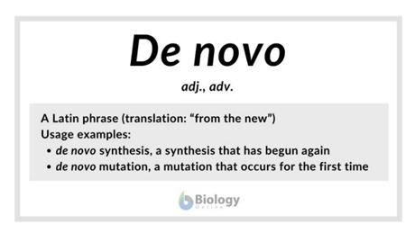
Machine Learning in De Novo Drug Design
Discussion 2: Learning to Navigate The Synthetically Accessible Chemical Space

Slide 12
Challenges in Current Generative Approaches for De Novo Drug Design
Therefore, an ideal model would:
Ensure that generated molecular structures are synthetically feasible.
navigate the chemical space to build novel structures, while analyzing synthesizability at each step.
Seamlessly integrates molecule design generation and molecule synthesis.
Feasible Synthesis: Generated structures may not be feasible for laboratory synthesis.
Exploitation of Heuristics: Risk of generating impractical molecules due to heuristic bias.
Disjoint Search Pipeline: Hinders seamless integration of molecule generation and synthesizability assessment.
Notes:
training in a manner that may not consider certain differing factors at each step. While these programs can provide valuable guidance, they do not ensure that

Slide 13
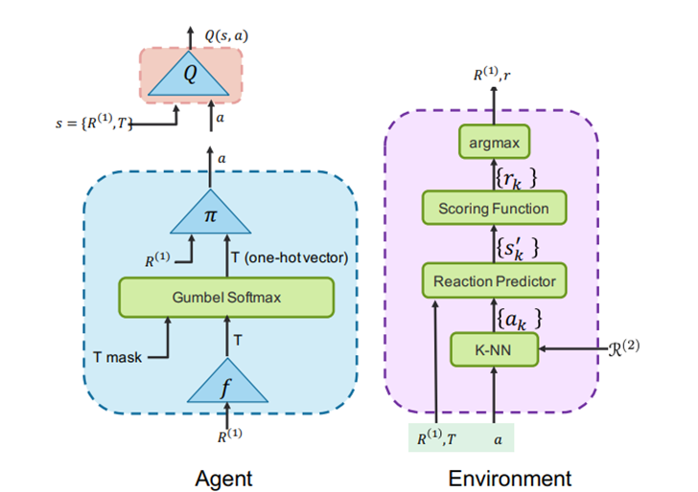
Policy Gradient for Forward Synthesis (PGFS)
State and Action: Reactant R(1)t as current state st; action ‘a’ determines reactant R(2)t.
Actor-Critic Framework: Three networks (f, π, Q)
Actor module includes f and π, while critic is Q network.
Actor Module takes current state st, predicts best reaction template Tt, computes action ‘a’.
k-NN for Action Selection: Selects k closest reactants.
Environment Response: Computes reward ‘r”, next state, and episode termination.
Notes:
Reinforcement Learning in Synthesizing Feasible Drug Molecular Structures
Initial Molecule Selection: Randomly samples the initial molecule from available reactants.

Slide 14
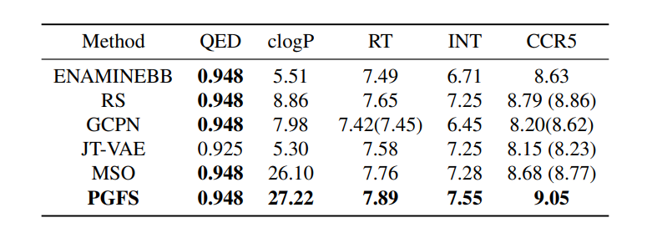
Results and Analysis
Methods Compared:
ENAMINEBB: A baseline method using the Enamine Building Block catalog.
RS: Random Sampling.
GCPN: Graph Convolutional Policy Network.
JT-VAE: Junction Tree Variational AutoEncoder.
MSO: Multi-Objective Optimization.
PGFS: Policy Gradient for Forward Synthesis
Metrics:
QED: Quantitative Estimate of Drug-likeness, a metric indicating the drug-likeness of a molecule.
clogP: Calculated logP, an estimate of the number of accurately reactive compounds generated.
RT: HIV Reverse Transcriptase, a target for HIV treatment.
INT: HIV Integrase, another target for HIV treatment.
CCR5: C-C Chemokine Receptor Type 5, an additional target for HIV treatment.
Notes:
GCPN - a method using graph convolutional networks in reinforcement learning.
JTVAE - an approach using variational autoencoders and junction tree representations for molecule generation.
MSO in the context of drug design typically refers to optimizing multiple objectives simultaneously. For example, in drug discovery, one might want to optimize a molecule for both its potency against a target and its drug-likeness properties.
where the numbers indicate pIC50 values predicting the effectiveness of compounds against the HIV-RT.

Slide 15
Conclusion and Future Prospects
DID YOU KNOW? Before the era of CADD, the average time to develop a new drug was around 10-15 years.
By 2025, the global market for CADD tools is projected to reach $4.1 billion.
Innovation in Drug Design: Introduced PGFS as the first tool using reinforcement learning for drug design.
Real-World Simulation: Showed that the approach works well in simulations.
Consistent Learning and Better Results: Consistently improved learning and found better drug candidates compared to existing methods.
FUTURE PROSPECTS:
Second Policy Gradient for f Network.
Integration with RL Algorithms for Continuous Action Space.
Enhanced Exploration of Chemical Space
Notes:
Innovation in Drug Design: Introduced PGFS as the first tool using reinforcement learning for drug design, navigating the space of possible small molecules.
Structured Approach: Used a step-by-step method where the computer decides on the next best reactant based on the current molecule.
Top Performance: Achieved top results in measuring drug-likeness and other important drug properties.
Real-World Simulation: Showed that our approach works well in simulations that resemble the real drug discovery process.
Consistent Learning and Better Results: Consistently improved learning and found better drug candidates compared to existing methods. Future Prospects: Introduction of a second policy gradient to update the f network based on the value of its corresponding critic, improving the selection of transformation templates and termination of episodes.
Exploration of using RL algorithms like Soft Actor-Critic (SAC) or hybrids of traditional planning and RL algorithms for better exploration of the chemical space.
Future developments aimed at enabling more efficient exploration of the chemical space, potentially leading to the discovery of novel and effective drug candidates.

Slide 16

Genetic Data Analysis

Slide 17

Genetic Data Analysis
Importance of Genetic Data Analysis in Healthcare
Single Nucleotide Polymorphisms (SNPs) - Useful markers for disease genes
Alzheimer’s Disease
Two groups - AD and Cognitively Normal (CN)
Notes:
Identifying genetic variants associated with complex diseases.
SNPs - The most common type of human genetic variation.

Slide 18
Data Collection and Preprocessing
Alzheimer's Disease Neuroimaging Initiative, Phase 1 (ADNI-1)
757 individuals – CN, Mild Cognitive Impairment (MCI), AD
Data Integrity
Closely related individuals
Data entries with substantial missing information
Final Dataset
751 subjects – 211 CN, 365 MCI, 175 AD, 566016 SNPs
Categorized as CN and AD, numerically 1 and 2, respectively.

Slide 19
Feature Selection
The AlzGene Dataset – 115 best SNPs
Feature Selection methods
Correlation-based Feature Selection with Greedy-Stepwise Search Algorithm
Chi-squared Attribute Evaluator with a ranker search method
Output
21 SNPs most associated with Alzheimer’s Disease
Notes:
SNPs highly correlated with the class, have low inter-dependence
SNPs ordered by their weights

Slide 20
Model: SVM with Sequential Minimal Optimization (SMO)
Support Vector Machines (SVM)
The advantages of using SVM:
Effectiveness in handling complex datasets
Ability to handle high-dimensional data
Why SMO Algorithm?
Large Quadratic Programming (QP) optimization problems
10-fold Cross Validation
Notes:
SMO - faster as it avoids complex optimization steps.

Slide 21
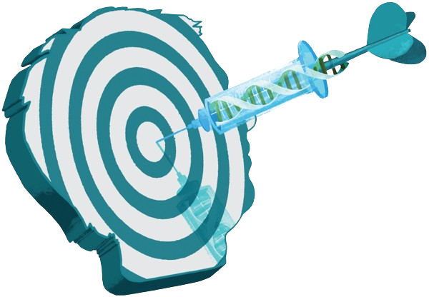
Pros, Cons, and Future Scope
Advantages:
Early Disease Detection
Personalized Treatments
Limitations:
Cost, Privacy Concerns
Limited Understanding
Future Developments:
Precision Medicine
Notes:
More effective treatment by personalizing it according to each person’s genes.
In the future, with more precise medicines based on genetics, we'll see even better treatments.

Slide 22
Conclusion
Pandemic Management
Improves predictive accuracy and decision-making under uncertainty
Accelerating Drug Development with ML
Reduces drug development costs and timelines
Genetic Data Analysis
Enables personalized treatment strategies
Notes:
Machine learning models
These models are changing how we do healthcare by improving predictive accuracy, reducing costs, and enabling personalized treatment strategies.

Slide 23
Thank You!
Contributions:
Rishabh Kalai – Pandemic Management
Priyanka Bhamare – Genetic Data Analysis
Sadhana Suresh Chettiar – Drug Design, Discovery and Development

